Slide 1

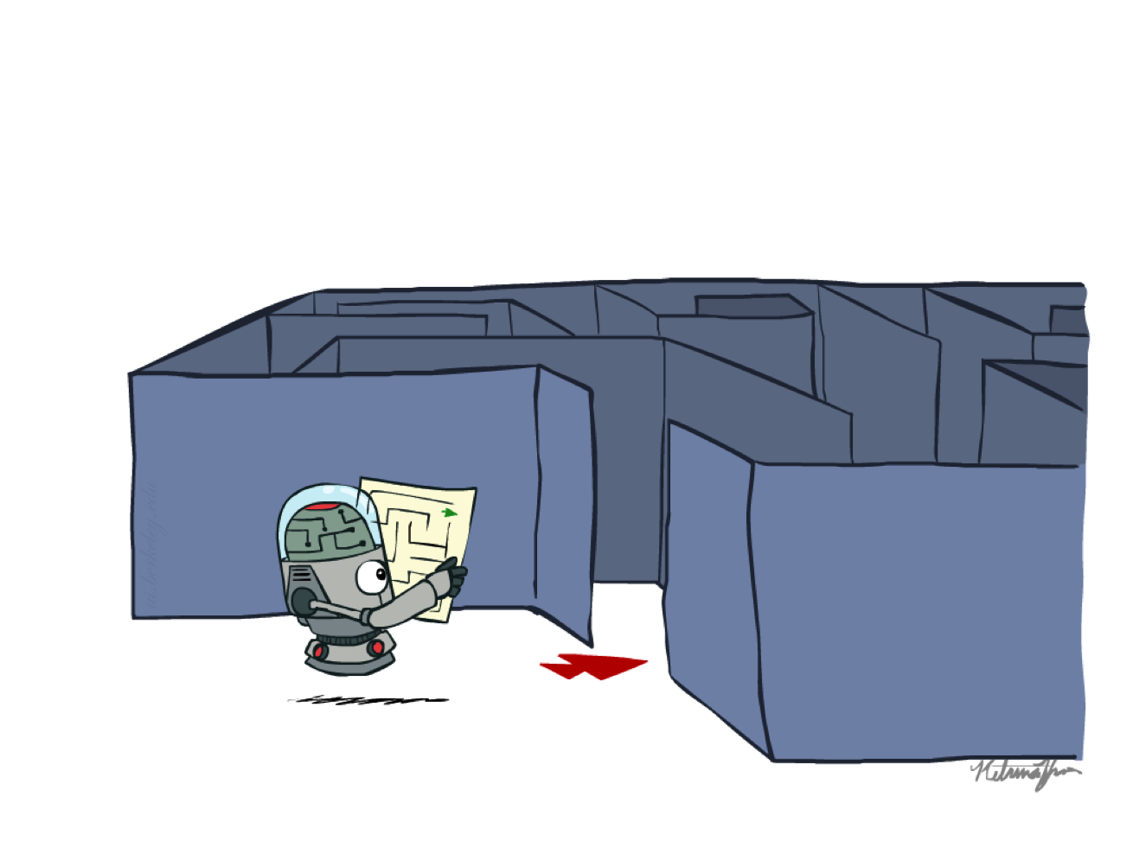
Chapter 1b
Informed Search
COMP 7404
Computational Intelligence and Machine Learning
K.P. Chow & Dirk Schnieders
Most materials in this chapter are based on materials from http://aima.cs.berkeley.edu/ and http://ai.berkeley.edu
http://ai.berkeley.edu

Slide 2
Outline
Abstraction
Types of Search
Search Problem Definition
State Space Graph vs. Search Tree
Search Algorithm (TSA, GSA)
Uninformed Search
BFS, DFS, UCS
Informed Search
Greedy, A*
Local Search
Constraint Satisfaction Problems
Adversarial Search
Minimax
DLS
Horizon Effect
𝛼-𝛽 Pruning
Expectimax
Multi-Agent Utilities

Slide 3
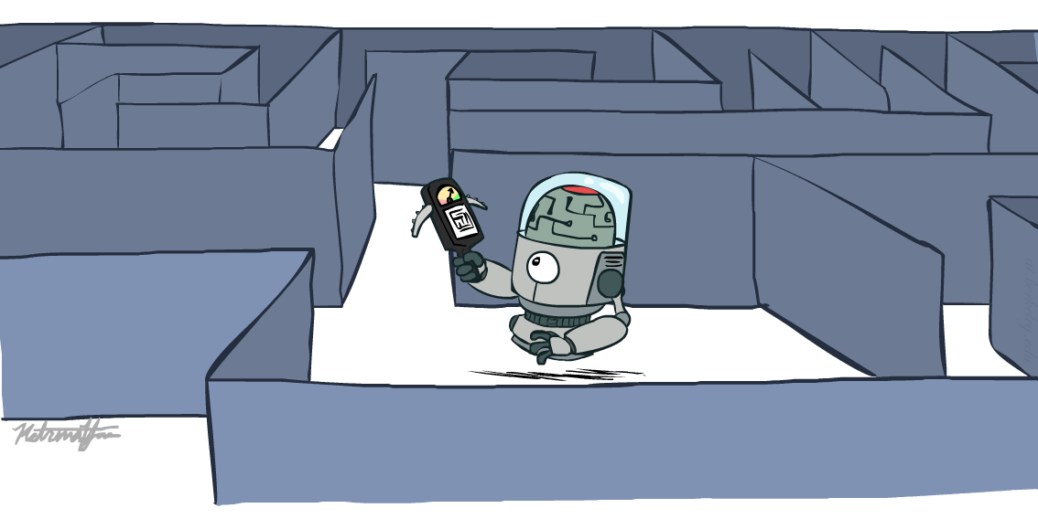
Informed Search
http://ai.berkeley.edu

Slide 4
Informed Search
Informed search strategies find solutions more efficiently than uninformed search strategies
They employ problem specific knowledge beyond the definition of the problem itself
Heuristic function
Examples
Greedy best-first search
A* search

Slide 5

Heuristic Function
A function that estimates how close you are to the goal
Designed for a particular search problem
h(n)
Cost (estimate) of the cheapest path from the state at node n to a goal state
If n is a goal node h(n) = 0
http://ai.berkeley.edu

Slide 6
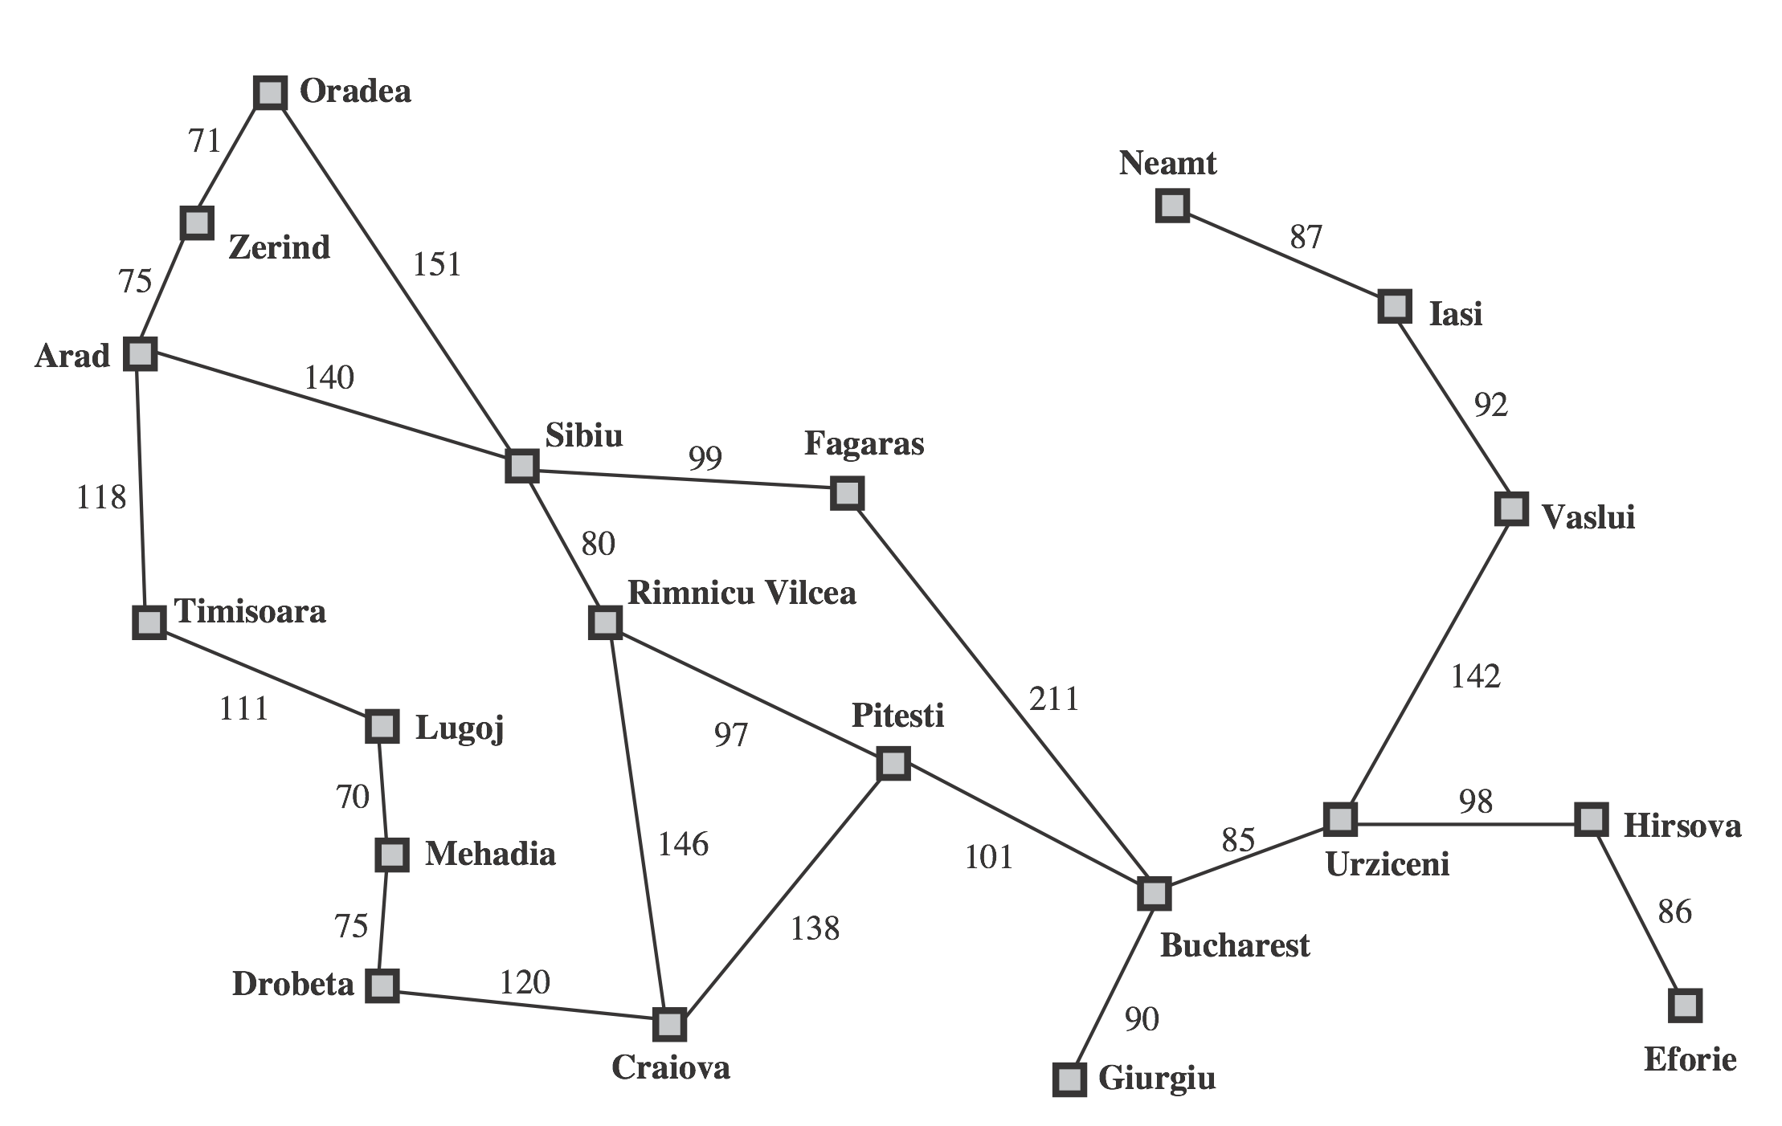
Romania Problem
Straight-line distance to B
n | h(n)
A | 366
B | 0
C | 160
D | 242
E | 161
F | 176
G | 77
H | 151
I | 226
L | 244
M | 241
N | 234
O | 380
P | 100
R | 193
S | 253
T | 329
U | 80
V | 199
Z | 374
http://aima.cs.berkeley.edu/
Notes:
---
Image extracted from Textbook

Slide 7
How about heuristic function for Chess?
Simple one:
King: 5; Queen: 5; Bishop: 3; Knight: 3; Prawn: 1
For player 1: sum of all his pieces on the board
Better one: weighted sum according to the position
Better better one:
Mobility, king safety, center control, …
It is a function!!!

Slide 8
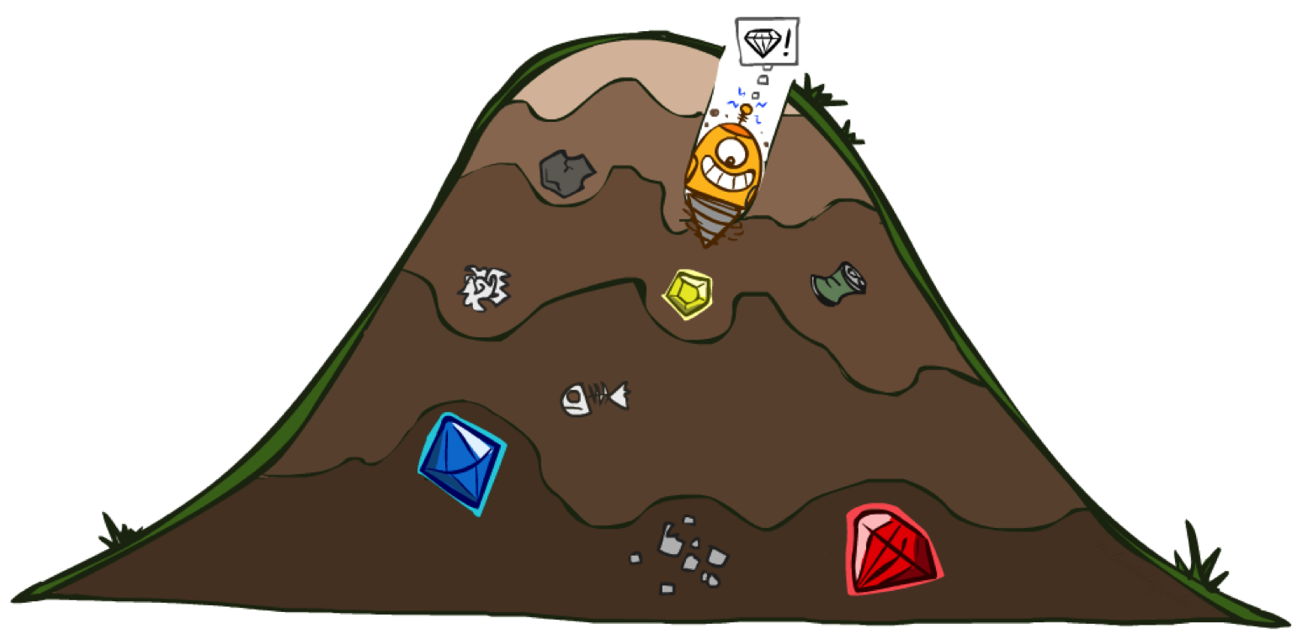
Greedy
http://ai.berkeley.edu
frontier is a priority queue (queue data structure where each element has a priority)

Slide 9

Greedy Search
Also known as best-first Search
Expand the node that has the lowest h(n)
What can possibly go wrong with this approach?
http://ai.berkeley.edu

Slide 10
http://aima.cs.berkeley.edu/
Straight-line distance to B
n | h(n)
A | 366
B | 0
C | 160
D | 242
E | 161
F | 176
G | 77
H | 151
I | 226
L | 244
M | 241
N | 234
O | 380
P | 100
R | 193
S | 253
T | 329
U | 80
V | 199
Z | 374
romaniaH = { 'A':366,'B':0,'C':160,'D':242,'E':161,'F':176,'G':77,'H':151,'I':226, 'L':244,'M':241,'N':234,'O':380,'P':100,'R':193,'S':253,'T':329,'U':80, 'V':199,'Z':374}

Slide 11
Straight-line distance to B
n | h(n)
A | 366
B | 0
C | 160
D | 242
E | 161
F | 176
G | 77
H | 151
I | 226
L | 244
M | 241
N | 234
O | 380
P | 100
R | 193
S | 253
T | 329
U | 80
V | 199
Z | 374
http://aima.cs.berkeley.edu/
Initial frontier: [(366, 'A')] Exploring: A at cost 366 [(253, 'AS'), (329, 'AT'), (374, 'AZ')] {'A'} Exploring: S at cost 253 [(176, 'ASF'), (329, 'AT'), (193, 'ASR'), (374, 'AZ'), (380, 'ASO'), (366, 'ASA')] {'A', 'S'} Exploring: F at cost 176 [(0, 'ASFB'), (329, 'AT'), (193, 'ASR'), (374, 'AZ'), (380, 'ASO'), (366, 'ASA'), (253, 'ASFS')] {'F', 'A', 'S'} Solution path: (0, 'ASFB')
Try it here
greedyTsaRomania.py
greedyGsaRomania.py

Slide 12
from heapq import heappush, heappop def greedyTsa(stateSpaceGraph, h, startState, goalState): frontier = [] heappush(frontier, (h[startState], startState)) print('Initial frontier:',list(frontier)); input() while frontier: node = heappop(frontier) if (node[1].endswith(goalState)): return node print('Exploring:',node[1][-1],'at cost',node[0]) for child in stateSpaceGraph[node[1][-1]]: heappush(frontier, (h[child[1]], node[1]+child[1])) print(list(frontier)); input() romania = { 'A':[(140,'S'),(118,'T'),(75,'Z')],'Z':[(75,'A'),(71,'O')],'O':[(151,'S'),(71,'Z')], 'T':[(118,'A'),(111,'L')],'L':[(70,'M'),(111,'T')],'M':[(75,'D'),(70,'L')], 'D':[(120,'C'),(75,'M')],'S':[(140,'A'),(99,'F'),(151,'O'),(80,'R')], 'R':[(146,'C'),(97,'P'),(80,'S')],'C':[(120,'D'),(138,'P'),(146,'R')], 'F':[(211,'B'),(99,'S')],'P':[(101,'B'),(138,'C'),(97,'R')],'B':[] } romaniaH = { 'A':366,'B':0,'C':160,'D':242,'E':161,'F':176,'G':77,'H':151,'I':226, 'L':244,'M':241,'N':234,'O':380,'P':100,'R':193,'S':253,'T':329,'U':80, 'V':199,'Z':374} print('Solution path:',greedyTsa(romania, romaniaH, 'A', 'B'))

Slide 13
Greedy-TSA Practice
Initial frontier: [(7, 'S')] Exploring: S at cost 7 [(0, 'SG'), (9, 'Sa'), (5, 'Sd')] Solution path: (0, 'SG')
Consider the following state space graph
Let S be the start state and G be the goal state
Perform Greedy-TSA and write down the order of explored states
10
h=9
5
h=4
2
h=2
a
b
c
4
3
S
1
1
G
h=7
h=0
3
2
h=5
4
Try it here
greedyTsaPractice.py
greedyGsaPractice.py
d
e
h=3

Slide 14
from heapq import heappush, heappop def greedyTsa(stateSpaceGraph, h, startState, goalState): frontier = [] heappush(frontier, (h[startState], startState)) print('Initial frontier:',list(frontier)); input() while frontier: node = heappop(frontier) if (node[1].endswith(goalState)): return node print('Exploring:',node[1][-1],'at cost',node[0]) for child in stateSpaceGraph[node[1][-1]]: heappush(frontier, (h[child[1]], node[1]+child[1])) print(list(frontier)); input() practice = { 'S':[(3,'a'),(2,'d'),(10,'G')],'a':[(5,'b')], 'd':[(1,'b'),(4,'e')],'G':[],'b':[(1,'e'),(2,'c')], 'e':[(3,'G')],'c':[(4,'G')]} practiceH = {'S':7,'a':9,'b':4,'c':2,'d':5,'e':3,'G':0} print('Solution path:',greedyTsa(practice, practiceH, 'S', 'G'))

Slide 15
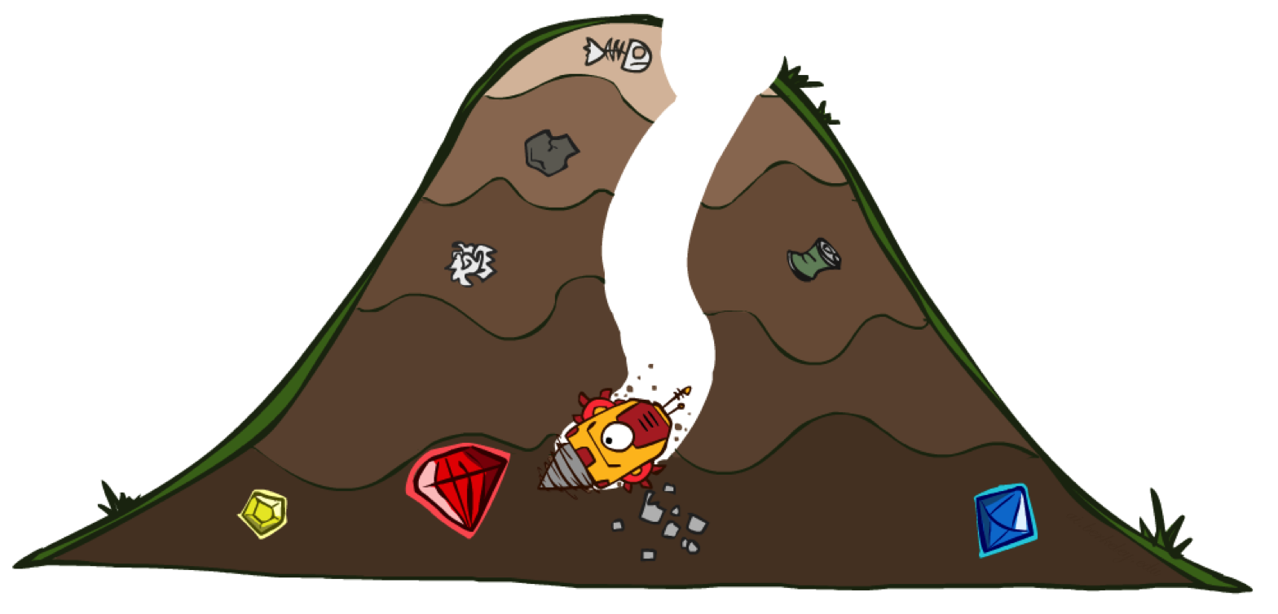
A*
http://ai.berkeley.edu
frontier is a priority queue (queue data structure where each element has a priority)

Slide 16
A* Motivation UCS-TSA
UCS orders by backward (actual) cost
g(n)
Initial frontier: [(0, 'S')] Exploring: S at cost 0 [(1, 'Sa')] Exploring: a at cost 1 [(2, 'Sab'), (4, 'Sad'), (9, 'Sae')] Exploring: b at cost 2 [(3, 'Sabc'), (9, 'Sae'), (4, 'Sad')] Exploring: c at cost 3 [(4, 'Sad'), (9, 'Sae')] Exploring: d at cost 4 [(6, 'SadG'), (9, 'Sae')] Solution path: (6, 'SadG')
h=1
e
8
1
1
3
2
h=6
S
a
d
G
h=5
h=0
h=2
1
h=7
c
1
b
h=6
Try it here
ucsTsaAStarMotivation.py

Slide 17
A* Motivation Greedy-TSA
Greedy orders by forward (estimated) cost
h(n)
h=1
Initial frontier: [(6, 'S')] Exploring: S at cost 6 [(5, 'Sa')] Exploring: a at cost 5 [(1, 'Sae'), (6, 'Sab'), (2, 'Sad')] Exploring: e at cost 1 [(2, 'Sad'), (6, 'Sab'), (2, 'Saed')] Exploring: d at cost 2 [(0, 'SadG'), (6, 'Sab'), (2, 'Saed')] Solution path: (0, 'SadG')
e
8
1
1
3
2
h=6
S
a
d
G
h=5
h=0
h=2
1
h=7
c
1
b
h=6
Try it here
greedyTsaAStarMotivation.py

Slide 18

The Tortoise and the Hare
http://ai.berkeley.edu
http://ai.berkeley.edu
http://ai.berkeley.edu
UCS
Greedy
A*
Notes:
The story concerns a Hare who ridicules a slow-moving Tortoise
Tired of the Hare's arrogant behavior, the Tortoise challenges him to a race
The hare soon leaves the tortoise behind and, confident of winning, takes a nap midway through the race
When the Hare awakes however, he finds that his competitor, crawling slowly but steadily, has arrived before him

Slide 19
A* Motivation A*-TSA
A* orders by backward cost + forward cost
f(n) = g(n) + h(n)
h=1
e
8
1
Exploring: S at cost 6 [(6, 'Sa')] Exploring: a at cost 6 [(6, 'Sad'), (8, 'Sab'), (10, 'Sae')] Exploring: d at cost 6 [(6, 'SadG'), (10, 'Sae'), (8, 'Sab')] Solution path: (6, 'SadG')
1
3
2
h=6
S
a
d
G
h=5
h=0
h=2
1
h=7
c
1
b
h=6
Try it here
aStarTsaAStarMotivation.py

Slide 20
from heapq import heappush, heappop def aStarTsa(stateSpaceGraph, h, startState, goalState): frontier = [] heappush(frontier, (h[startState], startState)) print('Initial frontier:',list(frontier)); input() while frontier: node = heappop(frontier) if (node[1].endswith(goalState)): return node print('Exploring:',node[1][-1],'at cost',node[0]) for child in stateSpaceGraph[node[1][-1]]: heappush(frontier, (node[0]+child[0]-h[node[1][-1]]+h[child[1]], node[1]+child[1])) print(list(frontier)); input() aStarMotivation = { 'S':[(1,'a')],'a':[(1,'b'),(3,'d'),(8,'e')],'b':[(1,'c')],'c':[],'d':[(2,'G')],'e':[(1,'d')]} aStarMotivationH = {'S':6,'a':5,'b':6,'c':7,'d':2,'e':1,'G':0} print('Solution path:',aStarTsa(aStarMotivation, aStarMotivationH, 'S', 'G'))

Slide 21
child = (path_cost, next_state)
S1
S2
node[0]
child[0]
node = (Old_cost, StateSeq)
New_cost = Old_cost + path_cost – h(S1) + h(S2)
h[node[1][–1]]
h[child[1]]

Slide 22
Straight-line distance to B
n | h(n)
A | 366
B | 0
C | 160
D | 242
E | 161
F | 176
G | 77
H | 151
I | 226
L | 244
M | 241
N | 234
O | 380
P | 100
R | 193
S | 253
T | 329
U | 80
V | 199
Z | 374
http://aima.cs.berkeley.edu/
Initial frontier: [(366, 'A')] Exploring: A at cost 366 [(393, 'AS'), (447, 'AT'), (449, 'AZ')] Exploring: S at cost 393 [(413, 'ASR'), (447, 'AT'), (415, 'ASF'), (449, 'AZ'), (671, 'ASO'), (646, 'ASA')] Exploring: R at cost 413 [(415, 'ASF'), (447, 'AT'), (417, 'ASRP'), (449, 'AZ'), (671, 'ASO'), (646, 'ASA'), (526, 'ASRC'), (553, 'ASRS')] Exploring: F at cost 415 [(417, 'ASRP'), (447, 'AT'), (526, 'ASRC'), (449, 'AZ'), (671, 'ASO'), (646, 'ASA'), (553, 'ASRS'), (450, 'ASFB'), (591, 'ASFS')] Exploring: P at cost 417 [(418, 'ASRPB'), (447, 'AT'), (526, 'ASRC'), (449, 'AZ'), (607, 'ASRPR'), (646, 'ASA'), (553, 'ASRS'), (591, 'ASFS'), (450, 'ASFB'), (671, 'ASO'), (615, 'ASRPC')] Solution path: (418, 'ASRPB')
Try it here
aStarTsaRomania.py
aStarGsaRomania.py

Slide 23
A*-TSA Practice
Consider the following state space graph
Let S be the start state and G be the goal state
Perform A*-TSA and write down the order of explored states
10
h=9
5
h=4
2
h=2
a
b
c
4
3
S
1
1
G
h=7
h=0
3
2
h=5
4
d
e
h=3

Slide 24
h=9
5
h=4
2
h=2
10
a
b
c
4
3
S
1
1
G
h=7
3
2
h=5
h=0
4
d
e
h=3
Initial frontier: [(7, 'S')] Exploring: S at cost 7 [(7, 'Sd'), (12, 'Sa'), (10, 'SG')] Exploring: d at cost 7 [(7, 'Sdb'), (9, 'Sde'), (10, 'SG'), (12, 'Sa')] Exploring: b at cost 7 [(7, 'Sdbc'), (7, 'Sdbe'), (10, 'SG'), (12, 'Sa'), (9, 'Sde')] Exploring: c at cost 7 [(7, 'Sdbe'), (9, 'SdbcG'), (10, 'SG'), (12, 'Sa'), (9, 'Sde')] Exploring: e at cost 7 [(7, 'SdbeG'), (9, 'SdbcG'), (10, 'SG'), (12, 'Sa'), (9, 'Sde')] Solution path: (7, 'SdbeG')
Try it here
aStarTsaPractice.py
aStarGsaPractice.py

Slide 25

Optimality of A*
http://ai.berkeley.edu

Slide 26
Is A* Optimal ?
h=6
a
3
1
h=7
h=0
S
G
5
Initial frontier: [(7, 'S')] Exploring: S at cost 7 [(5, 'SG'), (7, 'Sa')] Solution path: (5, 'SG')
What went wrong?
Try it here
aStarTsaInadmissible.py
aStarGsaInadmissible.py

Slide 27
Admissibility of Heuristic
A heuristic h(n) is admissible (optimistic)
0 <= h(n) <= h*(n)
where h*(n) is the true cost to the nearest goal

Slide 28
Admissibility of Heuristic
A heuristic h(n) is admissible (optimistic) if
0 <= h(n) <= h*(n),
where h*(n) is the true cost to the nearest goal from n
For which values of h(a) is h admissible?
h=6
a
3
1
h=7
h=0
S
G
5

Slide 29
If h(n) is admissible, …
h=2
a
3
1
h=7
h=0
S
G
5
Initial frontier: [(7, 'S')] Exploring: S at cost 7 [(5, 'SG'), (3, 'Sa’)] Exploring: a at cost 3 ...

Slide 30
Optimality of A*
Claim
A* is optimal if an admissible heuristic is used

Slide 31
Optimality of A*
Let
A be an optimal goal node
B be a suboptimal goal node
h be admissible
Claim
A will exit the frontier before B
A
B

Slide 32
Optimality of A*
Let n be an ancestor of A
Let both B and n be on the frontier
Claim
n will exit frontier before B
n
Proof
f(n) <= f(A)
f(A) < f(B)
n exits frontier before B
Follows from definition of admissibility and the fact that n is an ancestor of A
A
B
B is suboptimal

Slide 33
Optimality of A*
All ancestors of A will exit frontier before B
A will exit frontier before B
A* TSA is optimal
A
B

Slide 34
Optimality of A*
h=4
Is this problem admissible?
a
1
1
h=2
h=1
h=0
3
S
c
G
1
2
h=1
b
A heuristic h(n) is admissible (optimistic) if
0 <= h(n) <= h*(n),
where h*(n) is the true cost to the nearest goal from n

Slide 35
Optimality of A*
Try it here
aStarTsaInconsistent.py
aStarGsaInconsistent.py
h=4
a
1
1
h=2
h=1
h=0
3
S
c
G
1
2
GSA
TSA
h=1
Initial frontier: [(2, 'S')] Exploring: S at cost 2 [(2, 'Sb'), (5, 'Sa')] {'S'} Exploring: b at cost 2 [(4, 'Sbc'), (5, 'Sa')] {'S', 'b'} Exploring: c at cost 4 [(5, 'Sa'), (6, 'SbcG')] {'S', 'c', 'b'} Exploring: a at cost 5 [(3, 'Sac'), (6, 'SbcG')] {'S', 'c', 'a', 'b'} Solution path: (6, 'SbcG')
Initial frontier: [(2, 'S')] Exploring: S at cost 2 [(2, 'Sb'), (5, 'Sa')] Exploring: b at cost 2 [(4, 'Sbc'), (5, 'Sa')] Exploring: c at cost 4 [(5, 'Sa'), (6, 'SbcG')] Exploring: a at cost 5 [(3, 'Sac'), (6, 'SbcG')] Exploring: c at cost 3 [(5, 'SacG'), (6, 'SbcG')] Solution path: (5, 'SacG')
b
Looks good, this is the optimal solution
What went wrong ?

Slide 36
Consistency of Heuristic
h=4
Definition
Heuristic cost ≤ actual cost for each arc
h(a)-h(c) ≤ cost(a to c) 4 – 1 = 3 ≤ 1 (fail, not consistent)
Consequence of consistency
The f value along a path never decreases (monotone property)
h(a) ≤ cost(a to c) + h(c), or h(a) – h(c) ≤ cost(a to c)
Can you prove that A* GSA is optimal if the f value never decreases?
a
1
c
h=1
3
G
h=0

Slide 37
Consistency of Heuristic
h=4
a
h(a) > cost(a,c) + h(c)
1
1
h=2
h=1
h=0
3
S
c
G
1
2
h=1
b
Can you make h consistent?
Src | Dst | H(Src) | H(Dst) | Cost(Src,Dst) | Consistency (monotone)
S | a | 2 | 4 | 1 | OK
a | c | 4 | 1 | 1 | No
c | G | 1 | 0 | 3 | OK
S | b | 2 | 1 | 1 | OK
b | c | 1 | 1 | 2 | OK

Slide 38
Consistency of Heuristic
h=1
a
h(a) <= cost(a,c) + h(c)
1
1
h=2
h=1
h=0
3
S
c
G
1
2
h=1
b
Src | Dst | H(Src) | H(Dst) | Cost(Src,Dst) | Consistency (monotone)
S | a | 2 | 4 | 1 | OK
a | c | 1 | 1 | 1 | OK
c | G | 1 | 0 | 3 | OK
S | b | 2 | 1 | 1 | OK
b | c | 1 | 1 | 2 | OK

Slide 39
Optimality of A*
h=1
a
1
1
h=2
h=1
h=0
3
S
c
G
1
2
GSA
h=1
Initial frontier: [(2, 'S')] Exploring: S at cost 2 [(2, 'Sb'), (2, 'Sa')] {'S'} Exploring: b at cost 2 [(4, 'Sbc'), (2, 'Sa')] {'S', 'b'} Exploring: a at cost 2 [(3, ‘Sac'), (4, 'Sbc')] {'S', 'c', ‘b’, ‘a’} Exploring: c at cost 3 [(5, ‘SacG'), (4, 'Sbc')] {'S', 'c', 'a', 'b'} Solution path: (6, 'SbcG')
b
‘Sbc’ will not be explored by ‘c’ has explored already

